Slide 1

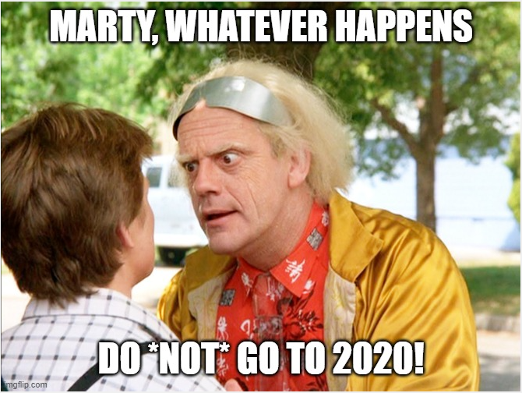

Burnout
more than just a bad day!
Seth Petry-Johnson

Slide 2
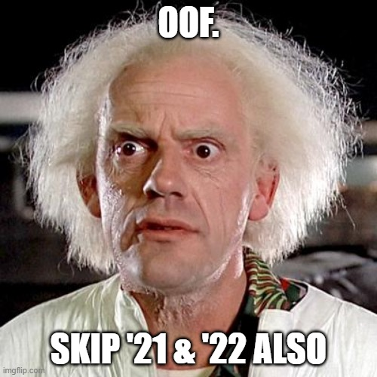
Burnout
more than just a bad day!
Seth Petry-Johnson
Notes:
Welcome to my talk on burnout.
I want to set the stage for this session by taking you on a brief trip backwards through time to 2020. You might recall that it was a fairly stressful time, what with the pandemic and the politics and all the upheaval in the workplace.
Lots of people were stressed out by being forced to suddenly work from home, whether or not they wanted to do so or had an area of their home that was conducive to it.
Other people, like myself, were already working from home and were quite used to it, so that part wasn’t stressful. But we weren’t necessarily used to sharing our nice, clean, quiet homes with the kids and spouses that were suddenly there all day long, every single day.
And don’t even get me started on remote learning; anyone that’s put an ADHD third grader through virtual school while working their own full-time job deserves combat pay, in my opinion.

Slide 3
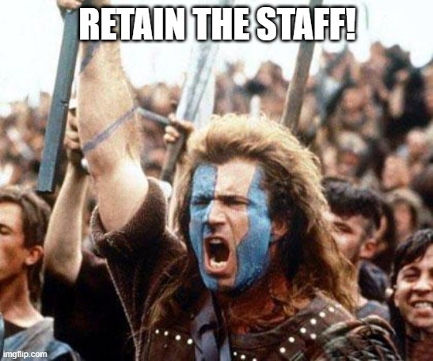
Burnout
more than just a bad day!
Seth Petry-Johnson
Notes:
Skip forward to 2021 and things aren’t necessarily getting better, but at least we’re getting used to the new normal. Maybe we’re still wearing dirty sweatpants to work and binge eating ice cream in bed, but we’re at least getting less embarrassed to admit it.
That’s progress, but still a long way from “good”.
At work, my company was starting to feel the impact of all that stress. People were grumpy, productivity was suffering, and we were facing a turnover crisis.
One employee would leave, which increased the workload on those that were left. We’d immediately look for a replacement, but the remaining employees were stressed out as well. They didn’t have the mental energy to handle the increased workload, so someone else would quit before the first person’s replacement was hired or fully trained. This was turning into a vicious cycle that was really hurting our business.

Slide 4
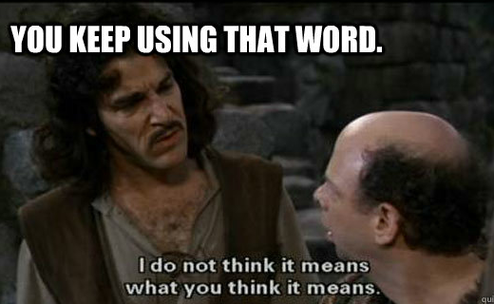
Burnout
more than just a bad day!
Seth Petry-Johnson
Notes:
In response, we set a major organizational goal for 2021 to stop the attrition and to retain our staff.
This was a key focus at all layers of management, so we started a process of discovery and analysis in all of our teams, not just the one that was experiencing the turnover.
And as we talked to people, they kept saying that they were “used up” or “burned out”.

Slide 5
Burnout
more than just a bad day!
Seth Petry-Johnson
Today’s agenda
Understanding burnout
Diagnosing and measuring burnout
Treating / managing burnout
Notes:
But when we tried to drill in, no one quite explained or thought about burnout in quite the same way.
It was a bit like the Supreme Court and pornography; everyone was certain they could identify burnout when they saw it or were feeling it, but couldn’t define it terms that helped us create an action plan to address it.
So, I decided to do some research into burnout. I wanted to know more about what caused it, whether there was any standard way of measuring it, and what we could do to recover from it.

Slide 6

Burnout
more than just a bad day!
Seth Petry-Johnson
Employed Americans w/ no ideas for reducing burnout
1 in 10
Today’s agenda
Understanding burnout
Diagnosing and measuring burnout
Treating / managing burnout
Notes:
And that brings us to today’s agenda.
This session is a summary of what I learned during that research and how I used that knowledge to quantitatively measure the burnout in my organization.
We’re going to start with a summary of a bunch of research to establish a scientific explanation of what burnout is and what causes it.
Then I’ll introduce a tool for measuring burnout on your own teams and I’ll share with you how we rolled out that tool at my company and what we learned from that process.
And then lastly, we’ll talk about how you can use those burnout measurements to more effectively treat or manage the burnout your staff is feeling.

Slide 7
Burnout
more than just a bad day!
Seth Petry-Johnson
Understanding burnout
Employed Americans reporting worker burnout
Today’s agenda
Diagnosing and measuring burnout
76%
Treating / managing burnout
Notes:
Lots of people think they are familiar with burnout;
A company called Spring Health sponsored a survey in 2020 to assess the state of the workplace. They found that 76% of American workers were reporting symptoms of burnout.
https://springhealth.com/wp-content/uploads/2020/12/Spring-Health-Burnout-Nation.pdf

Slide 8
Burnout
more than just a bad day!
Seth Petry-Johnson
Understanding burnout
Employed Americans reporting complete burnout
9%
Notes:
9% of US workers were reporting complete burnout that was having a debilitating impact on their ability to do their job.

Slide 9

Burnout
more than just a bad day!
Seth Petry-Johnson
Understanding burnout
Employed Americans w/ no ideas for reducing burnout
1 in 10
Notes:
And 1 in 10 workers reported having no ideas at all about how they might reduce burnout for themselves or others.

Slide 10
Burnout
more than just a bad day!
Seth Petry-Johnson
Understanding burnout
Employed Americans w/ no ideas for reducing burnout
1 in 10
Up to $190 BILLION in healthcare spending due to burnout
Notes:
All of this stuff has a very real cost;
The Harvard Business Review estimates that the annual cost of healthcare spending due to workplace burnout is between 125 and 190 billion dollars. That is a lot of money that could be much better spent elsewhere.
http://hbswk.hbs.edu/item/national-health-costs-could-decrease-if-managers-reduce-work-stress

Slide 11
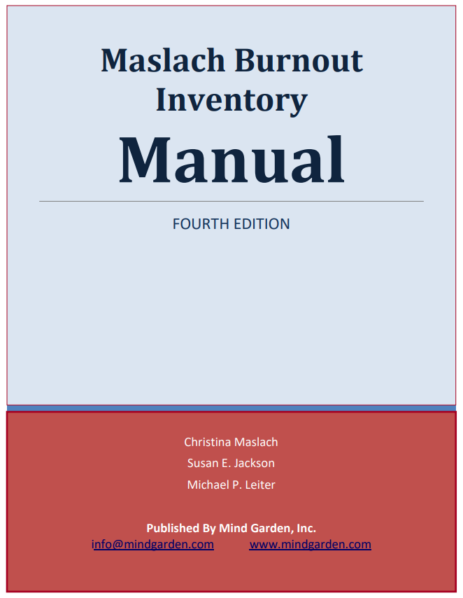
Burnout
more than just a bad day!
Seth Petry-Johnson
Understanding burnout
Burned out employees are 2.6 times more likely to quit
Notes:
Finally, a Gallup study found that burned-out employees are 63% more likely to take a sick day and 2.6 times more likely to actively seek a new job, leading to even more wasted money.
On average, replacing a full-time employee can cost over $15,000, and that doesn’t take into consideration the sort of cascading turnover we were worried about at my company.
(transition)
I have more stats like this, but I don’t think I need them because I don’t think you all need too much convincing that burnout is a problem.
It’s much more interesting to talk about what causes burnout, and how we progress through it.
Most of my research comes from three different publications.
http://hbswk.hbs.edu/item/national-health-costs-could-decrease-if-managers-reduce-work-stress

Slide 12
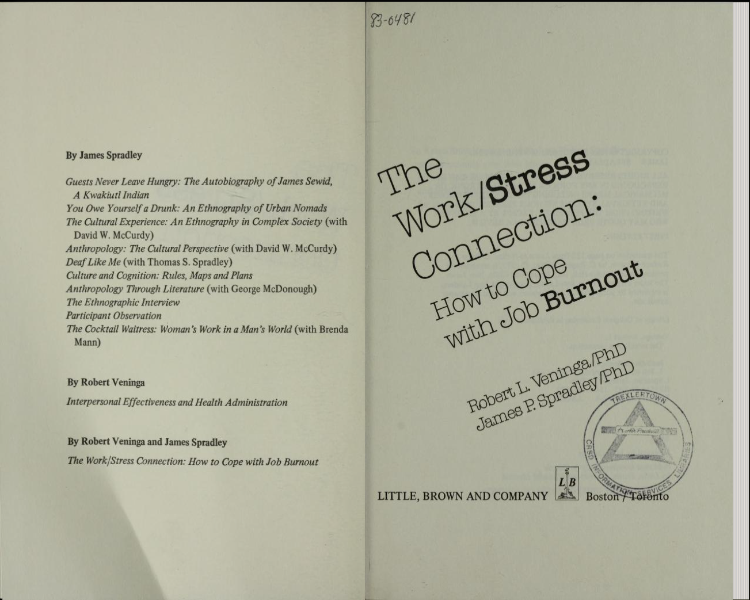
Burnout
more than just a bad day!
Seth Petry-Johnson
Understanding burnout
Burned out employees are 2.6 times more likely to quit
Notes:
The first is the Maslach Burnout Inventory, which was first published in 1981. That seems like a long time, but there was a ton of research into burnout in the ‘80s, and there has been follow up research performed since then.

Slide 13
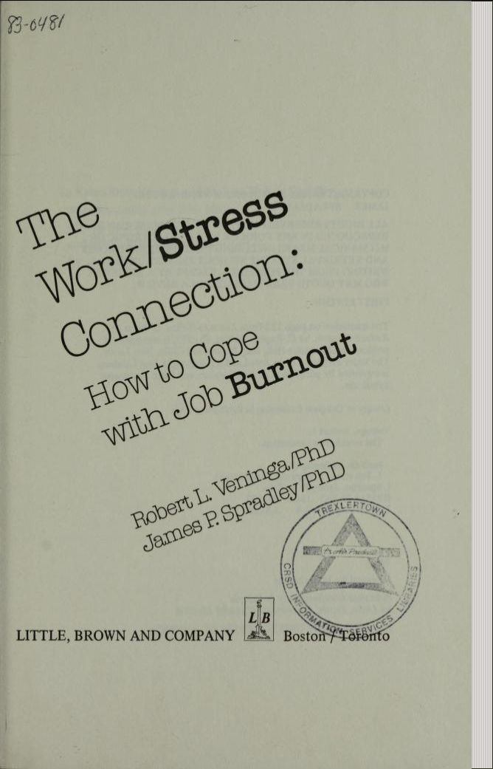
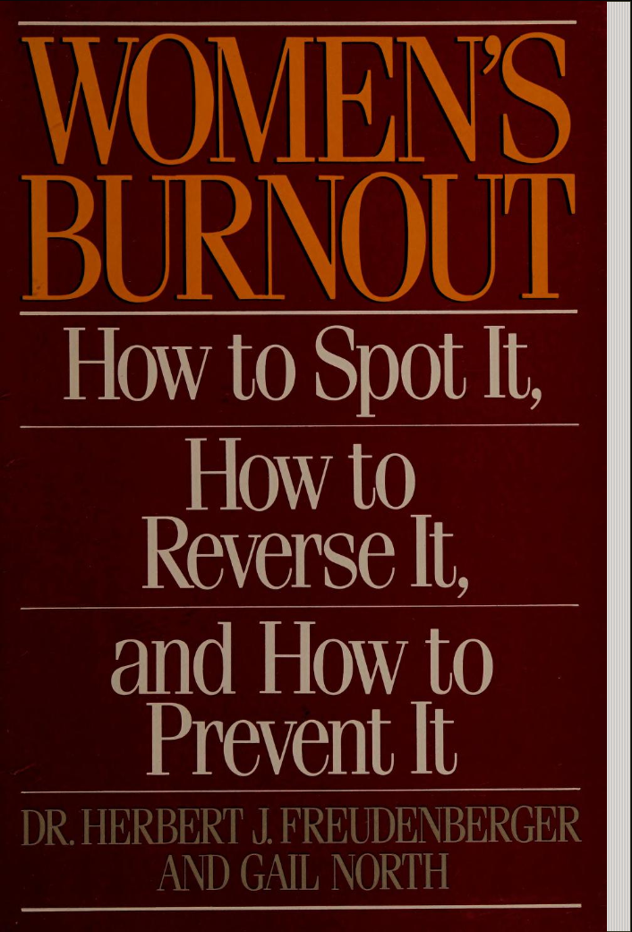
Burnout
more than just a bad day!
Seth Petry-Johnson
Understanding burnout
Notes:
The second resource I used was the Work/Stress Connection by Robert Veninga and James Spradley. This was also published in 1981 but is still considered one of the preeminent works on burnout; if you go home and do a web search right now, and you look at web articles published in the last year or two, many of them are based on the burnout model that Veninga and Spradley developed.

Slide 14
Burnout
more than just a bad day!
Seth Petry-Johnson
Understanding burnout
Notes:
The third book I referenced was Women’s Burnout by Herbert Fruedenberger and Gail North, which came out in ‘85. Like I said the 80s were a hoppin’ time for burnout research.
Even though this book was ostensibly written about women’s burnout, it is widely referenced today as having a more detailed general purpose burnout model than Veninga and Spradley.

Slide 15
Burnout
more than just a bad day!
Seth Petry-Johnson
Understanding burnout
Burnout is a syndrome,
not a specific diagnosis
Notes:
These three publications are all based on different research and offer a different perspective on burnout, but they generally agree that burnout is syndrome, not a specific diagnosis.

Slide 16
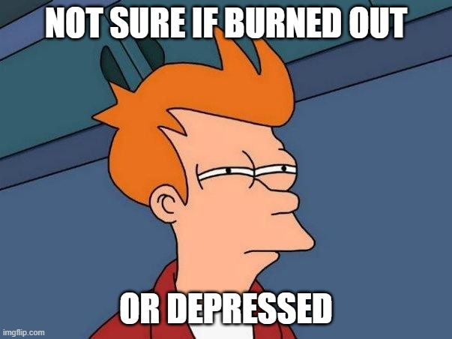
Burnout
more than just a bad day!
Seth Petry-Johnson
Understanding burnout
Burnout is a syndrome,
not a specific diagnosis
A syndrome is a group of symptoms that consistently occur together
Veninga and Spradley 5 stages
Notes:
A syndrome is just a group of symptoms that tend to occur together.
There’s no burnout bacteria or virus, there’s no blood test that you can take to determine if you’re burnt out, any sort of “diagnosis” is based on the symptoms of burnout that you report experiencing.
These symptoms can include a significant lack of energy, loss of motivation, withdrawing from relationships, etc. We’ll talk more about these symptoms in a minute.

Slide 17

Burnout
more than just a bad day!
Seth Petry-Johnson
Understanding burnout
Burnout is a syndrome,
not a specific diagnosis
A syndrome is a group of symptoms that consistently occur together
Veninga and Spradley 5 stages
Notes:
Before we do, however, it’s worth pointing out that many of those same symptoms also accompany depression.
This is where I remind you all that the human brain is a complex organ, that I am not a doctor, and that you definitely shouldn’t take medical advice from a used-to-be programmer at a technical conference.
Depression can make burnout worse, and burnout can make depression worse, so it’s never a bad idea to talk to your doctor for some insight.

Slide 18
Burnout
more than just a bad day!
Seth Petry-Johnson
Understanding burnout
Burnout is a syndrome,
not a specific diagnosis
A syndrome is a group of symptoms that consistently occur together
Veninga and Spradley 5 stages
Burnout symptoms accompany chronic unmanaged stress
in the workplace
Notes:
Whereas depression can be caused by chemical imbalances in the brain, all three of these publications agree that burnout is a response to chronic, unmanaged stress in the workplace.
That “workplace” distinction is important; these publications, and therefore this session, focus entirely on burnout at work. We’re not talking about how my daughter gets “burned out on chicken” when I cook it four nights in a row, or how you may get worn down by caring for an aging parent or whatever. We are talking specifically about how stress you experience at work affects your ability to do your job and interact with your coworkers.
Burnout at home surely exists, it just isn’t in scope for this discussion.

Slide 19
Burnout
more than just a bad day!
Seth Petry-Johnson
Veninga and Spradley 5 stages of workplace burnout
Notes:
These publications agree that burnout is a response to chronic, unmanaged stress, but they model that stress response differently.
Comparing how they model stress is interesting because it helps us understand how we move through the different stages of burnout.
Let’s start with Veninga and Spradley, who have a 5-stage model of burnout.

Slide 20


Burnout
more than just a bad day!
Seth Petry-Johnson
Veninga and Spradley 5 stages of workplace burnout
Honeymoon
High job satisfaction
Commitment / energy / creativity
Stress feels like “good stress”
Notes:
This model begins with the “Honeymoon Phase”. Most workers begin their jobs with enthusiasm and a desire to make it work out, and it’s exciting at the start when you’re meeting new people, learning new things, and demonstrating your competence to your new peers.
During this phase, stress often feels like “good stress”, in that it gives meaning to the work and adds to our sense of fulfillment. Maybe you’re working against a deadline, but you were hired specifically to help the team hit that deadline and so the time pressure is, in a way, validating your existence on the team.
If you’re well suited to your job, this phase can go on for a long time, well beyond when you’re considered “new”. Some people can sail along here for years, seemingly immune to the effects of that stress.
But for most people, there are two things that happen during this phase that contribute to burnout.

Slide 21
Burnout
more than just a bad day!
Seth Petry-Johnson
Veninga and Spradley 5 stages of workplace burnout
Honeymoon
High job satisfaction
Commitment / energy / creativity
Stress feels like “good stress” but still uses up adaptation energy
Finite resource used to fuel the “fight or flight” response caused by stress
Notes:
The first is that, even if the stress feels like good stress, it is still using up what is referred to as “adaptation energy”.
Millions of years ago most stress generally posed a direct threat to survival, so we evolved a highly automated “fight or flight” stress response.
When exposed to stress, the human brain instantly and automatically floods the body with signals and hormones that cause a sharp increase in energy consumption, readying muscles to fight or flee.
(click)
Early stress research identified this concept of “adaptation energy”, which is a finite resource that fuels that fight or flight response. When stress continues for a prolonged period the available adaptation energy burns up and eventually exhaustion sets in.

Slide 22
Burnout
more than just a bad day!
Seth Petry-Johnson
Veninga and Spradley 5 stages of workplace burnout
Honeymoon
High job satisfaction
Commitment / energy / creativity
Stress feels like “good stress” but still uses up adaptation energy
Obsolete stress response leads to burnout
Notes:
Veninga and Spradley believe that the basic cause of job burnout is that this fight or flight stress response has become obsolete.
A primitive human’s stress response only had to sustain them for a quick battle with the animal that would become dinner, but I’ve been on software projects that have taken months or even years to complete. That’s a constant level of stress over a very long time that our bodies just aren’t adapted to, and the modern workplace doesn’t have a lot of opportunities for vigorous physical activity to discharge the tension that the body built up in preparation for flight or flight.
The second thing that happens during the honeymoon phase is that we start to develop coping strategies for this constant workplace stress.
If those coping strategies aren’t effective at restoring that adaptation energy, then burnout starts to set in and we progress to phase 2.

Slide 23

Burnout
more than just a bad day!
Seth Petry-Johnson
Veninga and Spradley 5 stages of workplace burnout
Fuel Shortage
Honeymoon
Begin to overdraw adaptation energy
Vague feeling of loss
“Balancing act”
Notes:
The “Fuel Shortage” phase sets in when you overdraw your amount of adaptation energy.
This isn’t an acute thing that is super obvious; instead, it can happen slowly and be sort of subtle. You might have a vague feeling of loss or disappointment along with decreased enthusiasm for the job that comes and goes.
This is sometimes referred to as a “balancing act” because people in this stage are constantly balancing between fatigue and confusion on one hand and enthusiasm and control on the other.

Slide 24

Burnout
more than just a bad day!
Seth Petry-Johnson
Veninga and Spradley 5 stages of workplace burnout
Fuel Shortage
Chronic Symptoms
Honeymoon
Chronic exhaustion
Physical illness
Anger / depression

Slide 25

Burnout
more than just a bad day!
Seth Petry-Johnson
Symptoms become critical
Pessimism and self-doubt
“Escape mentality”
Veninga and Spradley 5 stages of workplace burnout
Fuel Shortage
Chronic Symptoms
Honeymoon
Crisis

Slide 26
Burnout
more than just a bad day!
Seth Petry-Johnson
Veninga and Spradley 5 stages of workplace burnout
Burnout transitions into significant and persistent physical or emotional problems
Fruedenberger’s 12 stages
Fuel Shortage
Chronic Symptoms
Hitting the Wall
Honeymoon
Crisis

Slide 27
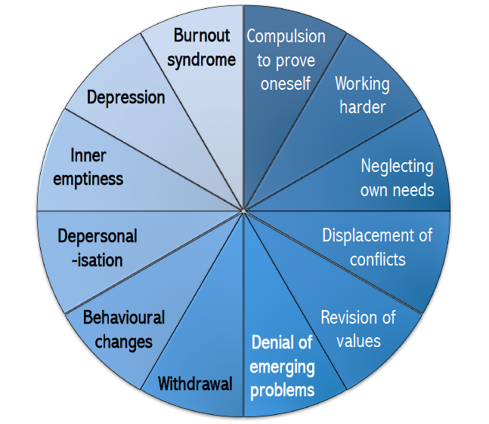
Burnout
more than just a bad day!
Seth Petry-Johnson
Veninga and Spradley 5 stages of workplace burnout
Fruedenberger’s 12 stages
Hitting the Wall
Honeymoon
→
Maslach Burnout Inventory 3 scales for measuring burnout

Slide 28

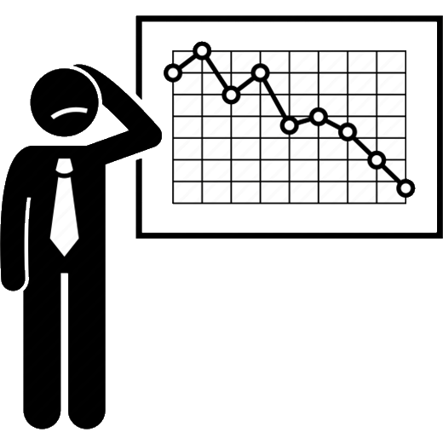
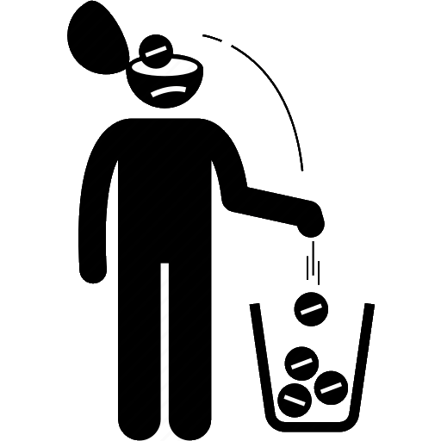
Burnout
more than just a bad day!
Seth Petry-Johnson
Veninga and Spradley 5 stages of workplace burnout
Maslach Burnout Inventory 3 scales for measuring burnout
Fruedenberger’s 12 stages
Hitting the Wall
Honeymoon
→
Exhaustion
Low Professional Efficacy
Cynicism

Slide 29
Burnout
more than just a bad day!
Seth Petry-Johnson
Maslach Burnout Inventory 3 scales for measuring burnout
Feelings related to work, not symptoms
Low Professional Efficacy
Exhaustion
Cynicism
Worn out by work
Energized by work
My work doesn’t matter
My work is valuable

Slide 30
Burnout
more than just a bad day!
Seth Petry-Johnson
Maslach Burnout Inventory 3 scales for measuring burnout
Measured on a spectrum
Low Professional Efficacy
Exhaustion
Cynicism
Worn out by work
Energized by work
My work doesn’t matter
My work is valuable

Slide 31
Burnout
more than just a bad day!
Seth Petry-Johnson
Maslach Burnout Inventory 3 scales for measuring burnout
Measured on a spectrum
Low Professional Efficacy
Exhaustion
Cynicism
Worn out by work
Energized by work
My work doesn’t matter
My work is valuable
I’m not good at my job
I make a difference

Slide 32
Burnout
more than just a bad day!
Seth Petry-Johnson
Maslach Burnout Inventory 3 scales for measuring burnout
Measured on a spectrum
Low Professional Efficacy
Exhaustion
Cynicism
Worn out by work
Energized by work
My work doesn’t matter
My work is valuable
I’m not good at my job
I make a difference

Slide 33


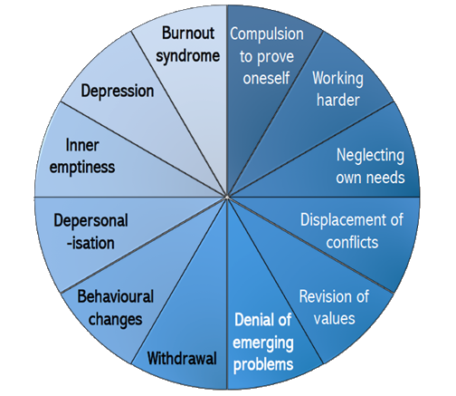

Burnout
more than just a bad day!
Seth Petry-Johnson
3 models of burnout
Low Professional Efficacy
Exhaustion
3 separate feelings
Progressively worsening symptoms
Worn out by work
Energized by work
I’m not good at my job
I make a difference
Cynicism
My work doesn’t matter
My work is valuable

Slide 34
Burnout
more than just a bad day!
Seth Petry-Johnson
Measuring burnout
Progressively worsening symptoms
Worn out by work
Energized by work

Slide 35
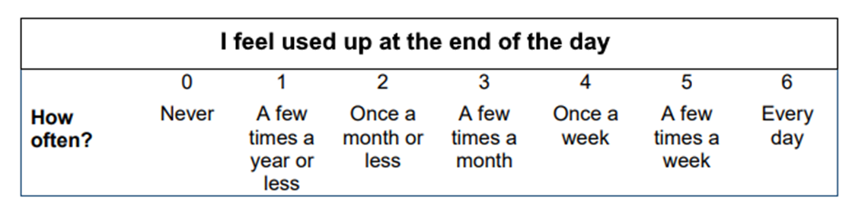
Burnout
more than just a bad day!
Seth Petry-Johnson
Measuring burnout
Burnout Inventory
Areas of Worklife Survey
Measures 3 types of feelings to
provide a burnout “score”
Suggests reasons for burnout due to mismatch w/ key aspects of job/role
Exhaustion

Slide 36
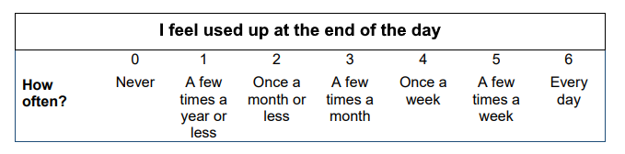
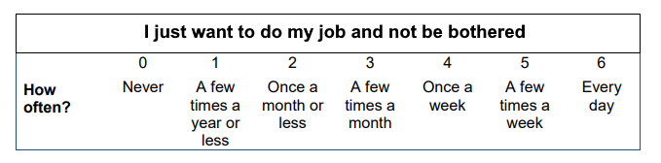
Burnout
more than just a bad day!
Seth Petry-Johnson
Measuring burnout
Areas of Worklife Survey
Suggests reasons for burnout due to mismatch w/ key aspects of job/role
Exhaustion
Burnout Inventory
Measures 3 types of feelings to provide a burnout “score”
Cynicism

Slide 37
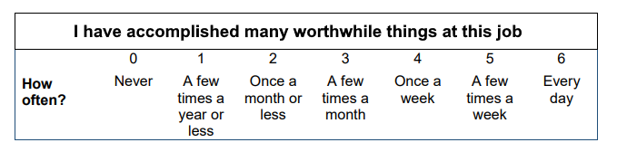
Burnout
more than just a bad day!
Seth Petry-Johnson
Measuring burnout
Exhaustion
Cynicism
Burnout Inventory
Measures 3 types of feelings to provide a burnout “score”
Professional Efficacy

Slide 38
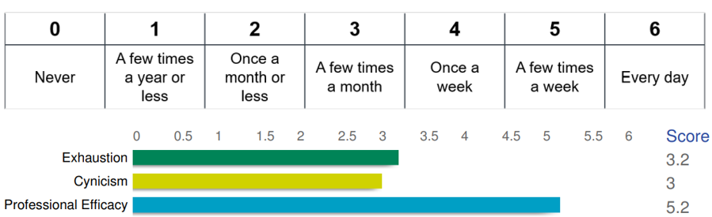
Burnout
more than just a bad day!
Seth Petry-Johnson
Measuring burnout
Exhaustion
Cynicism
Burnout Inventory
Measures 3 types of feelings to provide a burnout “score”
Professional Efficacy

Slide 39
Burnout
more than just a bad day!
Seth Petry-Johnson
Measuring burnout
Exhaustion
Cynicism
Burnout Inventory
Measures 3 types of feelings to provide a burnout “score”
Professional Efficacy

Slide 40
Burnout
more than just a bad day!
Seth Petry-Johnson
Measuring burnout
Burnout Inventory
Measures 3 types of feelings to provide a burnout “score”
For Exhaustion and Cynicism,
higher numbers contribute to burnout

Slide 41
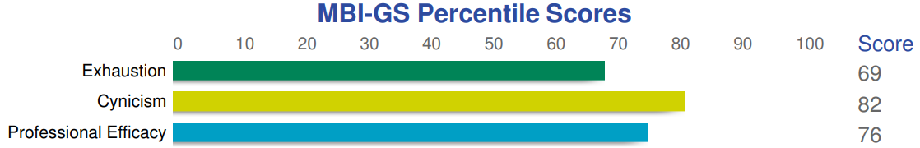
Burnout
more than just a bad day!
Seth Petry-Johnson
Measuring burnout
Burnout Inventory
Measures 3 types of feelings to provide a burnout “score”
For Professional Efficacy,
Lower numbers contribute to burnout

Slide 42
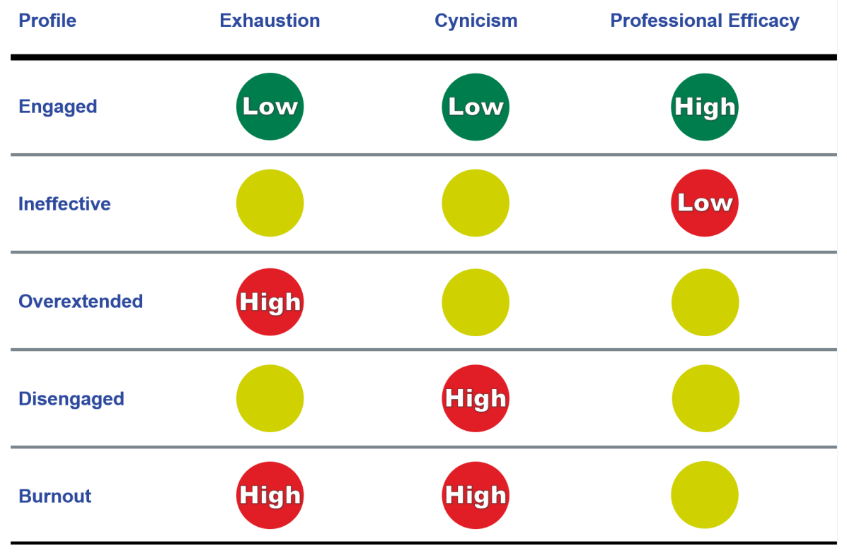
Burnout
more than just a bad day!
Seth Petry-Johnson
Measuring burnout
Percentage of people experiencing this feeling with less frequency than respondent
For Professional Efficacy,
Lower numbers contribute to burnout
Burnout Inventory
Measures 3 types of feelings to provide a burnout “score”

Slide 43
Percentage of people experiencing this feeling with less frequency than respondent
Burnout
more than just a bad day!
Seth Petry-Johnson
Measuring burnout
Good scores across all 3 scales
Burnout Inventory
Measures 3 types of feelings to provide a burnout “score”

Slide 44
Burnout
more than just a bad day!
Seth Petry-Johnson
Measuring burnout
Burnout Inventory
Measures 3 types of feelings to provide a burnout “score”
One primary driver of burnout

Slide 45
Burnout
more than just a bad day!
Seth Petry-Johnson
Measuring burnout
Burnout Inventory
Measures 3 types of feelings to provide a burnout “score”
Two primary drivers of burnout

Slide 46
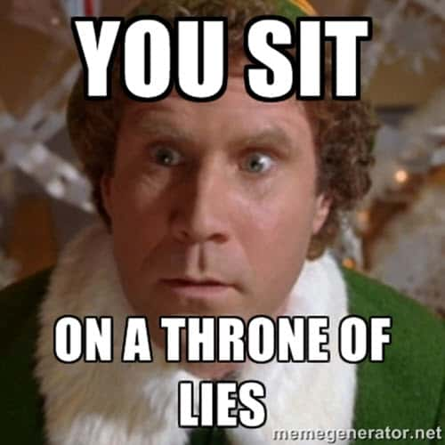

Burnout
more than just a bad day!
Seth Petry-Johnson
Measuring burnout
Burnout Inventory
Measures 3 types of feelings to provide a burnout “score”
Two primary drivers of burnout

Slide 47
Burnout
more than just a bad day!
Seth Petry-Johnson
Measuring burnout
The reliability of the three MBI scales exceeds recommended levels for research studies
The validity of the MBI has been demonstrated by numerous studies
Burnout Inventory
Measures 3 types of feelings to provide a burnout “score”
Two primary drivers of burnout

Slide 48
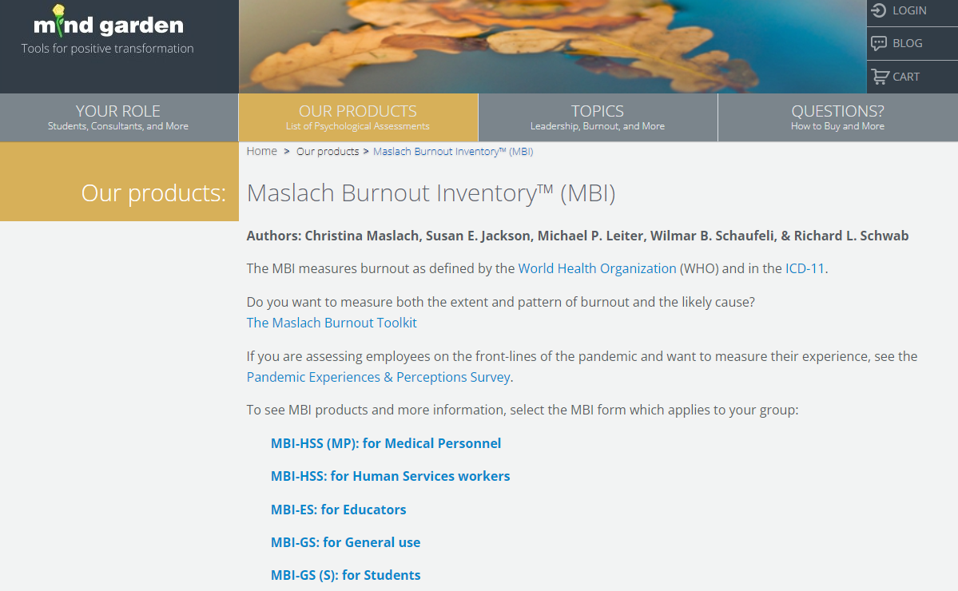
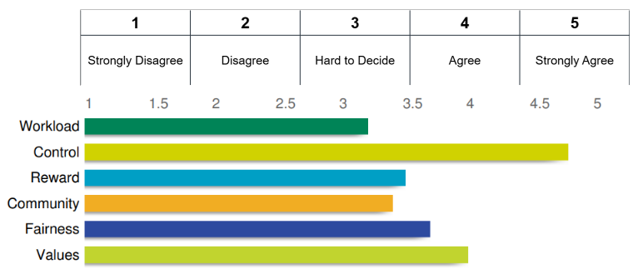
Burnout
more than just a bad day!
Seth Petry-Johnson
Measuring burnout
The reliability of the three MBI scales exceeds recommended levels for research studies
The validity of the MBI has been demonstrated by numerous studies
Burnout Inventory
Measures 3 types of feelings to provide a burnout “score”
Areas of Worklife Survey
Suggests reasons for burnout due to mismatch w/ key aspects of job/role

Slide 49
The reliability of the three MBI scales exceeds recommended levels for research studies
The validity of the MBI has been demonstrated by numerous studies
Burnout Inventory
Measures 3 types of feelings to provide a burnout “score”
Burnout
more than just a bad day!
Seth Petry-Johnson
Measuring burnout
Areas of Worklife Survey
Suggests reasons for burnout due to mismatch w/ key aspects of job/role

Slide 50
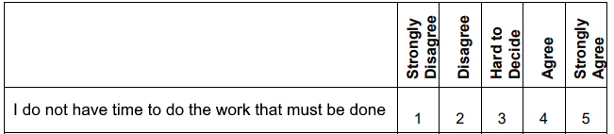
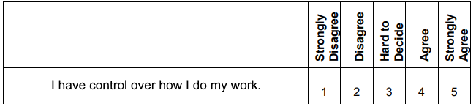
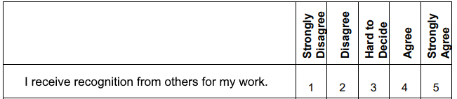
Burnout
more than just a bad day!
Seth Petry-Johnson
Measuring burnout
Exhaustion
Control
Areas of Worklife Survey
Suggests reasons for burnout due to mismatch w/ key aspects of job/role
Reward

Slide 51
Burnout
more than just a bad day!
Seth Petry-Johnson
Rolling out the MBI to your team
Areas of Worklife Survey
Suggests reasons for burnout due to mismatch w/ key aspects of job/role

Slide 52
Burnout
more than just a bad day!
Seth Petry-Johnson
Rolling out the MBI to your team
MindGarden.com

Slide 53




Burnout
more than just a bad day!
Seth Petry-Johnson
Rolling out the MBI to your team
MindGarden.com
Burnout Inventory Manual
$50.00 – Only need 1
Transform Survey Hosting
$2.50 per person
Individual Report
$2.50 per person
Group Report
$200 per report

Slide 54
Burnout
more than just a bad day!
Seth Petry-Johnson
Rolling out the MBI to your team
Burnout Inventory Manual
$50.00 – Only need 1
Transform Survey Hosting
$2.50 per person
Individual Report
$2.50 per person
Group Report
$200 per report
MindGarden.com

Slide 55
Burnout
more than just a bad day!
Seth Petry-Johnson
Rolling out the MBI to your team
Burnout Inventory Manual
$50.00 – Only need 1
Required
Transform Survey Hosting
$2.50 per person
Individual Report
$2.50 per person
Group Report
$200 per report
MindGarden.com

Slide 56
Burnout
more than just a bad day!
Seth Petry-Johnson
Rolling out the MBI to your team
Burnout Inventory Manual
$50.00 – Only need 1
Required
Transform Survey Hosting
$2.50 per person
Individual Report
$2.50 per person
Pick one (or both)
Group Report
$200 per report
MindGarden.com

Slide 57

Burnout
more than just a bad day!
Seth Petry-Johnson
Rolling out the MBI to your team
Burnout Inventory Manual
$50.00 – Only need 1
Transform Survey Hosting
$2.50 per person
Total cost for my 25 person company was $xxx
Individual Report
$2.50 per person
Group Report
$200 per report
MindGarden.com

Slide 58
Burnout
more than just a bad day!
Seth Petry-Johnson
Rolling out the MBI to your team
Burnout Inventory Manual
$50.00 – Only need 1
Transform Survey Hosting
$2.50 per person
Total cost for my 25 person company was $xxx
Individual Report
$2.50 per person
Group Report
$200 per report
MindGarden.com

Slide 59
Burnout
more than just a bad day!
Seth Petry-Johnson
Rolling out the MBI to your team
Use a neutral facilitator
MindGarden.com

Slide 60
Burnout
more than just a bad day!
Seth Petry-Johnson
Rolling out the MBI to your team
Use a neutral facilitator
Do not describe as a “burnout” assessment
MindGarden.com

Slide 61
Burnout
more than just a bad day!
Seth Petry-Johnson
Rolling out the MBI to your team
Use a neutral facilitator
Do not describe as a “burnout” assessment
Minimize response bias
MindGarden.com

Slide 62
Burnout
more than just a bad day!
Seth Petry-Johnson
Rolling out the MBI to your team
Use a neutral facilitator
Do not describe as a “burnout” assessment
Minimize response bias
Ensure confidentiality
MindGarden.com

Slide 63
Burnout
more than just a bad day!
Seth Petry-Johnson
Rolling out the MBI to your team
Use a neutral facilitator
Do not describe as a “burnout” assessment
Minimize response bias
Ensure confidentiality
Voluntary participation
MindGarden.com

Slide 64
Burnout
more than just a bad day!
Seth Petry-Johnson
Putting the data to use
Exhaustion
Cynicism
Low Efficacy
Use a neutral facilitator
Do not describe as a “burnout” assessment
MindGarden.com
Minimize response bias
Ensure confidentiality
Voluntary participation

Slide 65
Burnout
more than just a bad day!
Seth Petry-Johnson
Putting the data to use
Exhaustion
Adjust workload / expectations / PTO
Cynicism
Demonstrate impact of their work
Low Efficacy
Training / feedback / imposter syndrome
Use a neutral facilitator
Do not describe as a “burnout” assessment
MindGarden.com
Minimize response bias
Ensure confidentiality
Voluntary participation

Slide 66
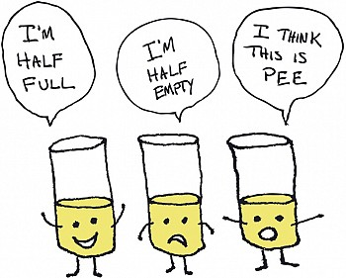
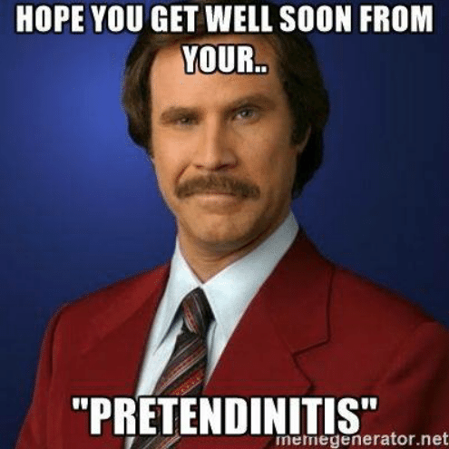
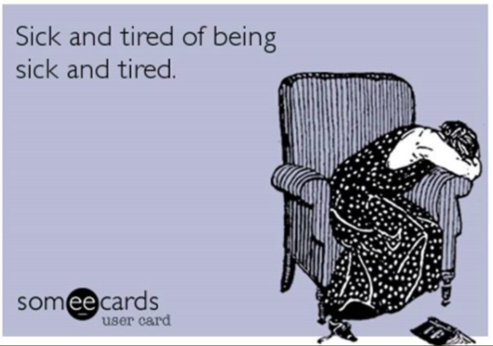
Burnout
more than just a bad day!
Seth Petry-Johnson
Understanding burnout
Burnout symptoms:
Depleted energy reserves
Lowered resistance to illness
Increased dissatisfaction and pessimism

Slide 67
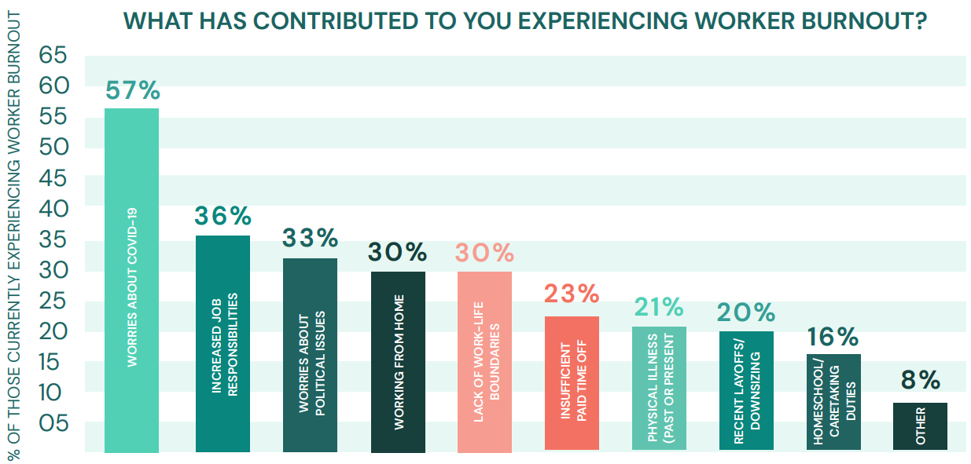
Burnout
more than just a bad day!
Seth Petry-Johnson
Understanding burnout
Employed Americans w/ no ideas for reducing burnout
2020
1 in 10
Notes:
And 1 in 10 workers reported having no ideas at all about how they might reduce burnout for themselves or others.

Slide 68
Burnout
more than just a bad day!
Seth Petry-Johnson
Understanding burnout
2023?
Notes:
And 1 in 10 workers reported having no ideas at all about how they might reduce burnout for themselves or others.

